Slide 1


YES / NO Questions
VERB TO BE

Slide 2
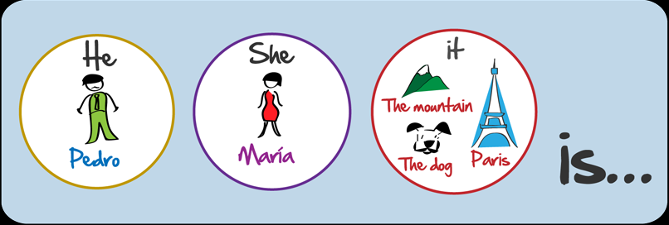


Slide 3
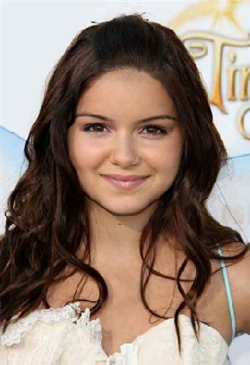
Alexandra ("Alex“) Dunphy
Female
Age: 16
Student at Icpna
she / student ? (Positive answer)
her / nickname / Ally ? (Negative answer)
she / 18 years old ? (Negative answer)
her / last name / Dunphy ? (Positive answer)

Slide 4
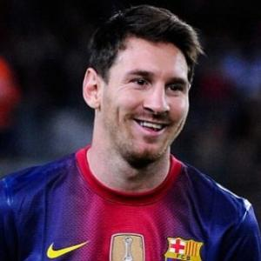
Lionel (‘Leo’) Andrés Messi
Male
Age: 25
Soccer player
he / doctor ? (Negative answer)
his / nickname / Leo ? (Positive answer)
he / 25 years old ? (Positive answer)
his / first name / Messi ? (Negative answer)

Slide 5

WH -
WORD

Slide 6
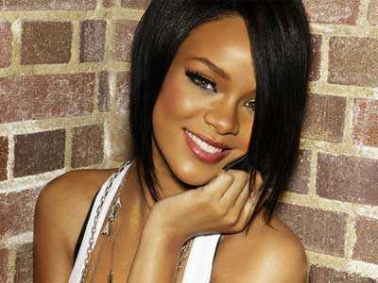

Slide 7
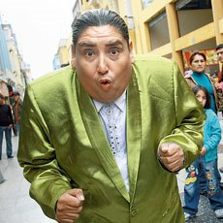

Slide 8
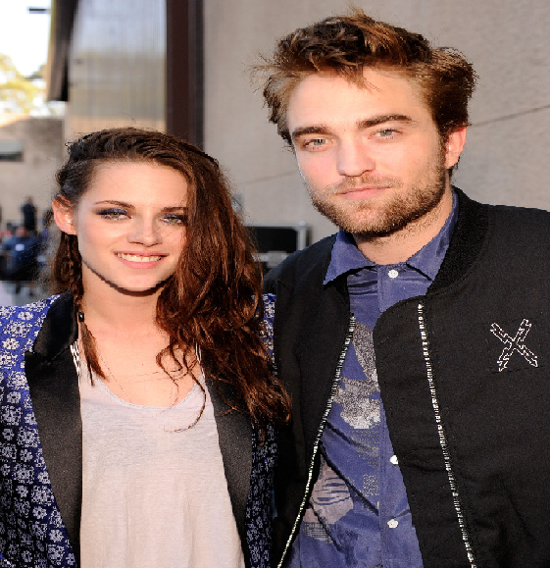

Slide 9

WH -
WORD

Slide 10

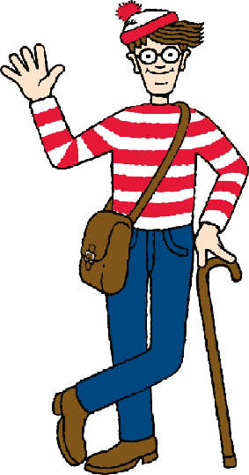

Slide 11
